Slide 1
PROBLEM SOLVING AND PROGRAMMING USING PYTHON
Mr.Panduraju Pagidimalla
Assistant Professor, Dept of AIML

Slide 2
Unit-I: Introduction to Python

Slide 3
Literals

Slide 4
Literals
Literals, also referred as constants, are data items that does not change its value during program execution.
Types of Literals in Python:
  String Literals
  Character Literal
  Numeric Literal
  Boolean Literal
  Special Literal

Slide 5
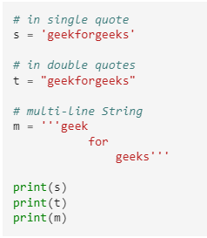
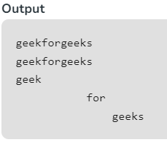
String Literals
A string is literal and can be created by writing a text (a group of Characters ) surrounded by a single(‘), double(“), or triple quotes.

Slide 6
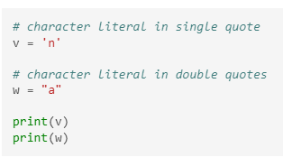
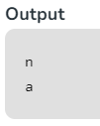
Character Literal
It is also a type of Python string literal where a single character is surrounded by single or double quotes.

Slide 7
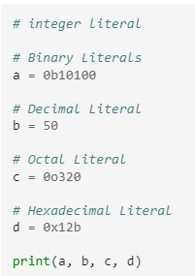

Numeric Literal
There are three types of numeric literal:
  1. Integer : Both positive and negative numbers including 0. There should not be any fractional part.

Slide 8
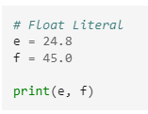

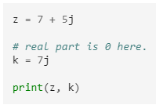

  2. Float : These are real numbers having both integer and fractional parts.
  3. Complex : The numerals will be in the form of a + bj, where ‘a’ is the real part and ‘b‘ is the complex part.

Slide 9
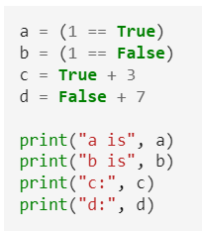
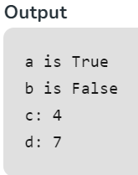
Boolean Literal
There are only two Boolean literals in Python:
  true and false.
In Python, True represents the value as 1, and False represents the value as 0.

Slide 10

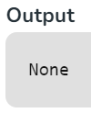
Special Literal
‘None’ is used to define a null variable.
If ‘None’ is compared with anything else other than a ‘None’, it will return false.

Slide 11
Python Suite

Slide 12
Groups of individual statements making up a single code block are called suites in Python.
Compound or complex statements, such as if, while, def, and class, are those which require a header line and a suite.
Header lines begin the statement (with the keyword) and terminate with a colon ( : ) and are followed by one or more lines which make up the suite.
  if expression :
  suite
  elif expression :
  suite
  else :
  suite

Slide 13
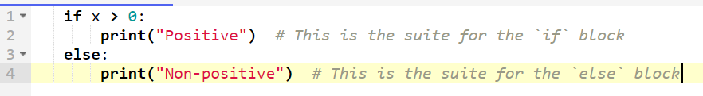

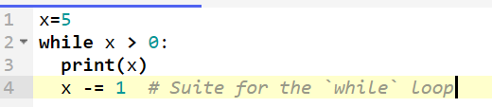
Examples
An `if`, `elif`, or `else` block contains a suite of indented code that is executed when the condition is met.
Both `for` and `while` loops execute a suite repeatedly, based on the condition.

Slide 14
Quotation in Python

Slide 15
Quotation in Python
Python accepts single ('), double (") and triple (''' or """) quotes to denote string literals, as long as the same type of quote starts and ends the string.
The triple quotes can be used to span the string across multiple lines. For example, all the following are legal:
word = 'word'
sentence = "This is a sentence."
paragraph = """This is a paragraph. It is made up of multiple lines and sentences."""

Slide 16
Comments

Slide 17
Comments
Comments in Python are the lines in the code that are ignored by the interpreter during the execution of the program.

Slide 18
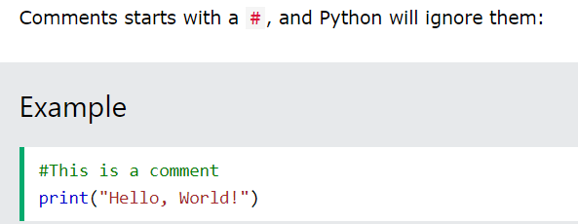
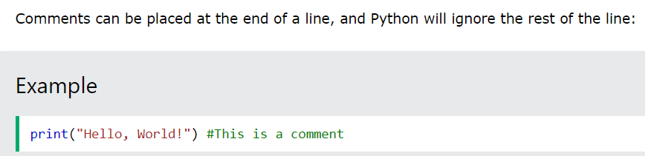

Slide 19
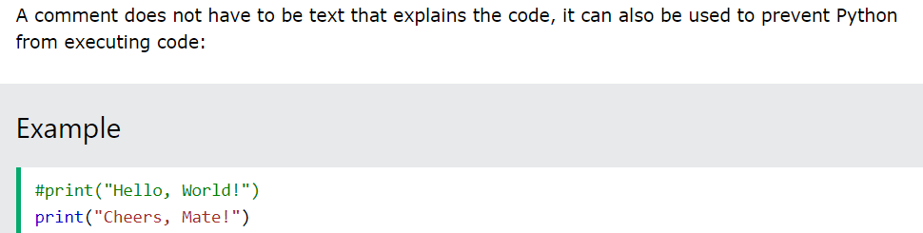

Slide 20
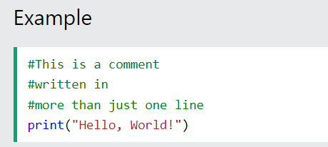
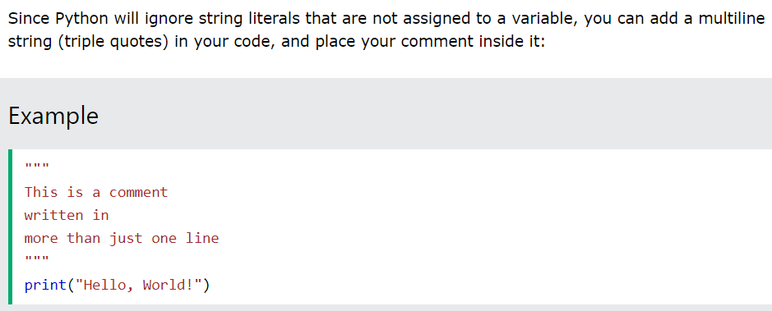
Multiline Comments

Slide 21
Advantages
Comments enhance the readability of the code
It also helps in collaborating with other developers as adding comments makes it easier to explain the code.

Slide 22
THANK YOU !

